Slide 1
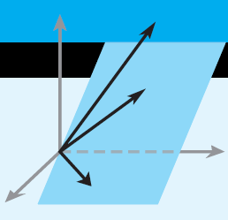
Elementary Linear Algebra
Chapter 7
Notes:
*

Slide 2
Chapter 7
7.1 Orthogonal Matrices
7.2 Orthogonal Diagonalization
7.3 Quadratic Forms
7.5 Hermitian, Unitary Matrices
Notes:
*

Slide 3
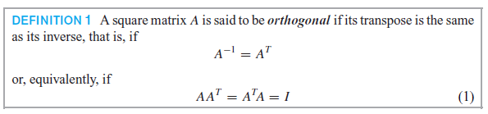
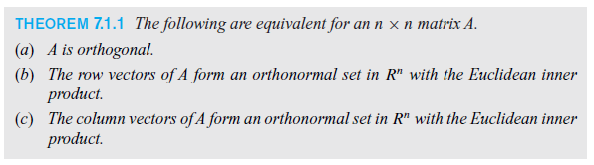
7.1 Orthogonal Matrices
Notes:
*

Slide 4
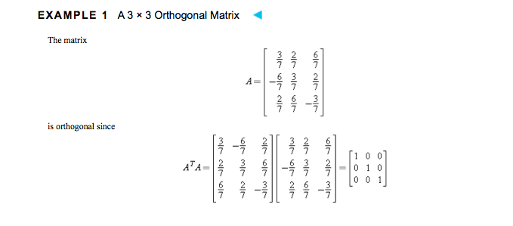

Slide 5
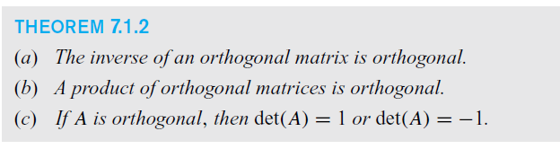
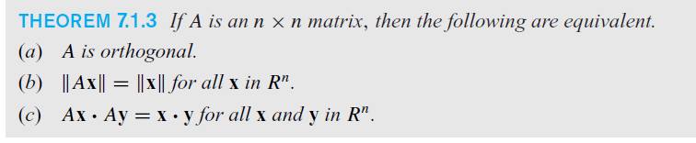
Notes:
*

Slide 6
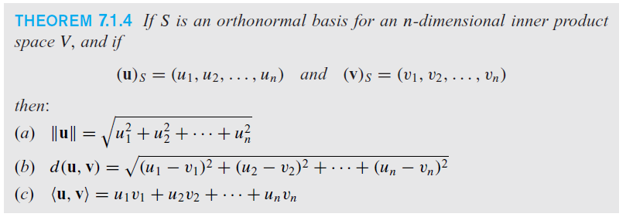
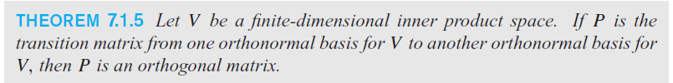
Orthonormal Basis
Notes:
*

Slide 7
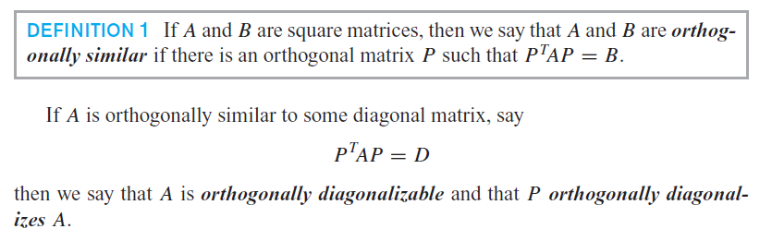
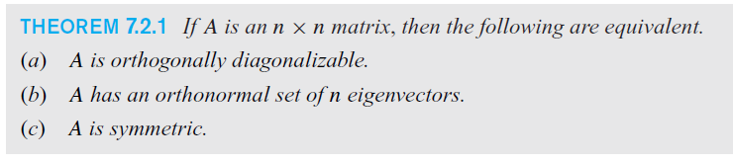
Orthogonal Diagonalization
Notes:
*

Slide 8
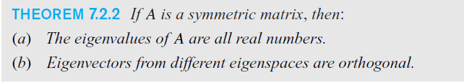
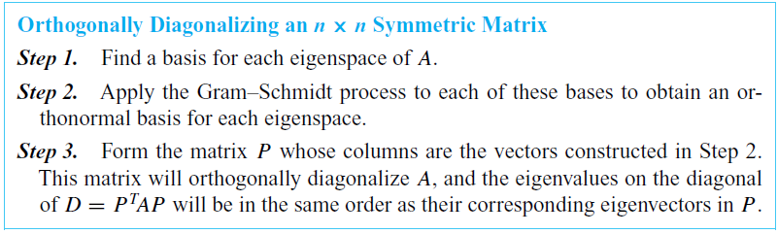
Symmetric Matrices
Notes:
*

Slide 9


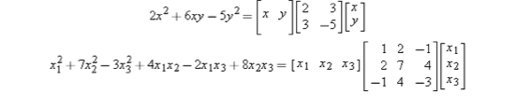
7.3 Quadratic Forms

Slide 10
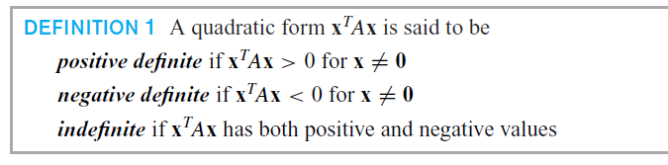
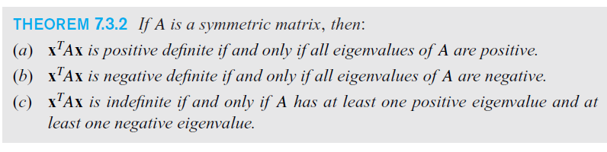
Definite quadratic forms
Notes:
*

Slide 11
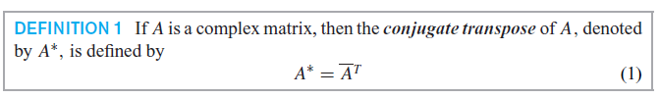
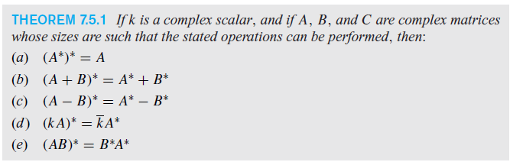
Section 7.5 Hermitian, Unitary and Normal Matrices
Notes:
*

Slide 12
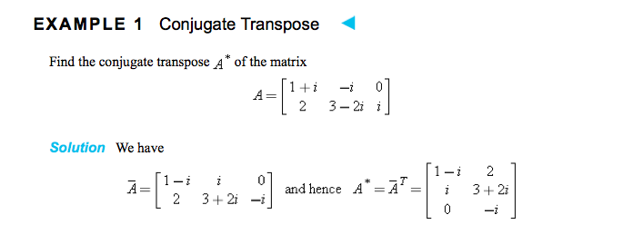

Slide 13
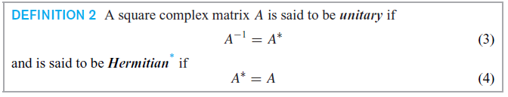

Hermitian Matrices
Notes:
*

Slide 14
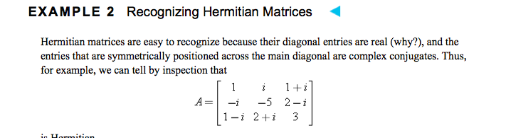

Slide 15
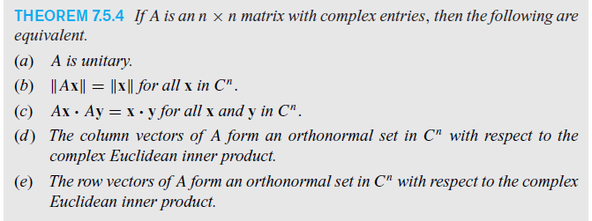

Unitary Matrices
Notes:
*

